Slide 1
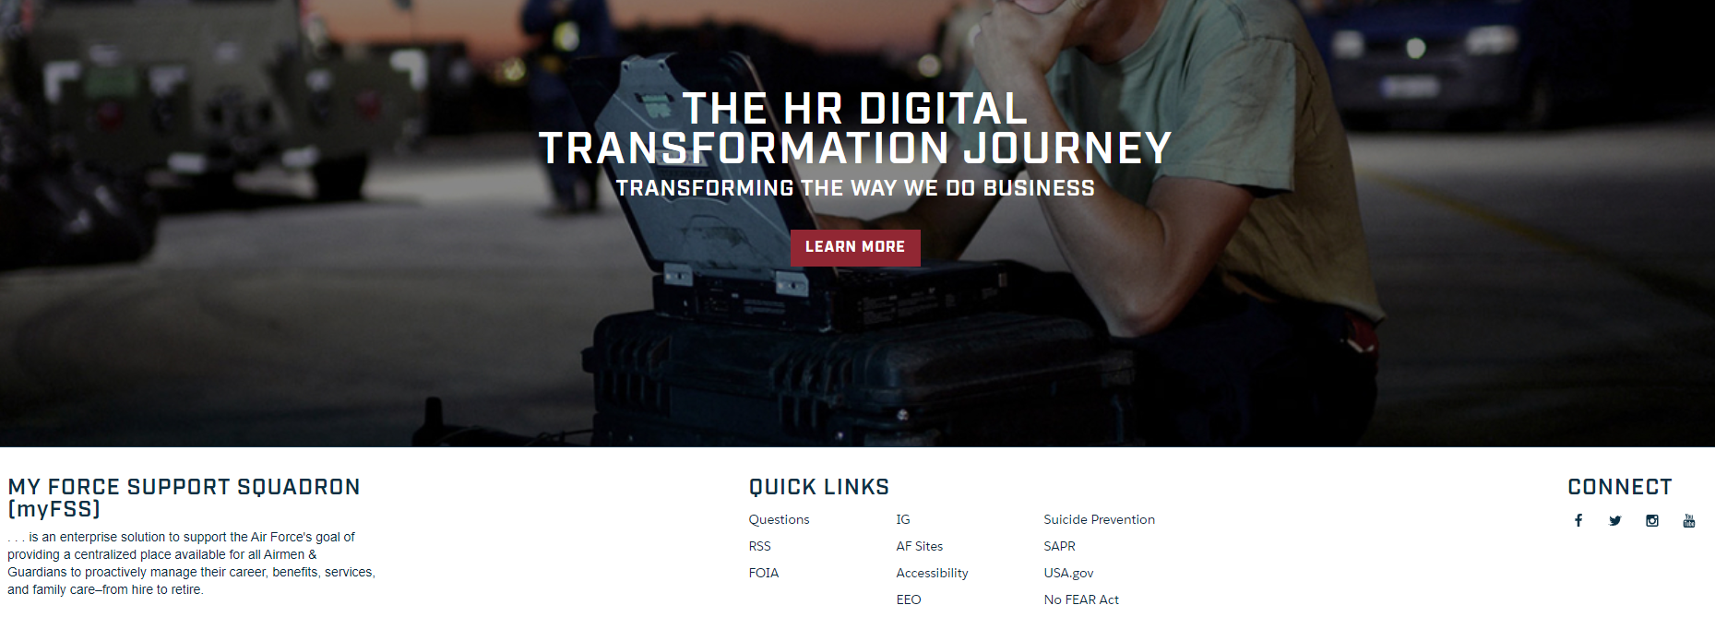
myFSS
WHAT YOU NEED TO KNOW
Education and Training
The Department of the Air Force is giving myPers and the virtual Personnel Center (vPC) a technical refresh by migrating current capabilities to the CRM platform, myFSS. The new platform improves services to Airmen and Guardians, consolidates HR platforms, and reduces IT investments and vulnerabilities.
The Education and Training application will soon be available to Airmen and Guardians (civilian and military) across all components through the new myFSS platform. Once the application is live, an Education and Training Tile will be visible to users on the myFSS home landing page. The Education and Training application will be comprised of multiple capabilities that will allow Education Service Technicians to efficiently manage their programs.
Transfer of Education Benefits (TEB) Functionality Overview & Benefits for End Users:
The Ability for Education Services Technicians to process TEB applications from cradle-to-grave. The servicing center will contact member’s regarding their TEB applications directly from myFSS.
Improved eligibility verification, member/technician interaction when necessary and improved workflow and queue management capabilities to escalate cases when necessary.
No member initiation required. As with myPers, member’s DO NOT have to submit a request in myFSS.
Email notification to member’s when the TEB application is received and in the queue for processing along with eligibility verification results and further instruction (if applicable).
TEB Dashboard for BPO’s to manage timeliness and see open/closed requests.
Reporting capabilities to manage inventory and workload.
Accessing the myFSS platform
The myFSS platform is enabled by OKTA single sign-on (CAC users only). Using Google Chrome, you can access my FSS at https://myfss.us.af.mil/.

Slide 2
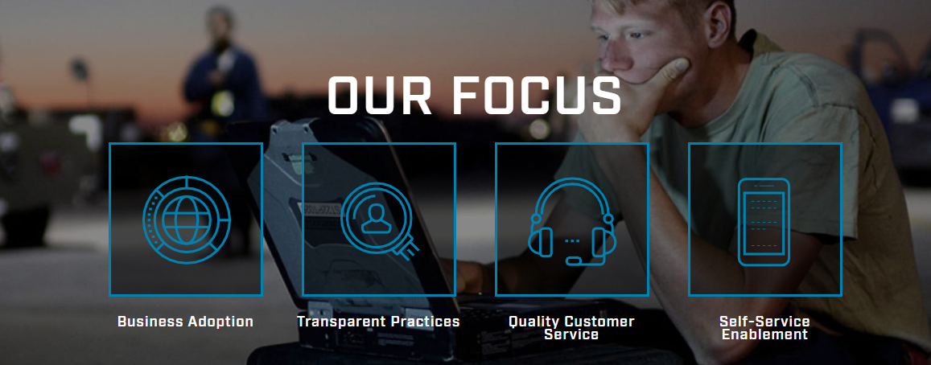
myFSS
Education and Training on myFSS
What is the timeframe for this change and when will I be expected to use myFSS for Education and Training Related Programs?
Senior Leaders have been working on developing a strategy to ensure users are aware of the migration of the Education and Training capability to myFSS and trained on how to use the application prior to Go-Live
The application is currently being built and tested
At this point, end users are not expected to utilize the new application until June/July 2022
How will I be supported during the change?
Additional communications prior to go-live will be sent out by the business process owners
A link to additional information and tools such as training aids and knowledge articles on the A1 Delivers Education and Training channel.
Have Questions? Need Help?
For OKTA or Log in issues around the myFSS platform, contact the A1 Service Desk
Phone: 1-800-525-0102, Option #5
Email: afpoa.a1.sd@us.af.mil
Accessing the myFSS platform
The myFSS platform is enabled by OKTA single sign-on (CAC users only). Using Google Chrome, you can access my FSS at https://myfss.us.af.mil/.

